Slide 1
NTE 1010
Introduction to Finance for Engineers
Spring 2020
week
10
Central Banks

Slide 2
NTE 1010 – Introduction to Finance for Engineers
Central Banks
Among the most important players in financial markets throughout the world are central banks,
the government authorities in charge of monetary policy.
(Governments are in charge in charge fiscal policy.)
Central banks’ actions affect interest rates, the amount of credit, and the money supply,
all of which have direct impacts not only on financial markets,
but also on aggregate output and inflation.

Slide 3
NTE 1010 – Introduction to Finance for Engineers
Central Banks
US Federal Reserve System (Fed)
The Federal Reserve System was created in 1913 to lessen the frequency of bank panics.
Because of public hostility to central banks and the centralization of power,
the system was created with many checks and balances to diffuse power.
It consists of 12 regional Federal Reserve banks,
around 2,500 member commercial banks,
the Board of Governors, the Federal Open Market Committee (FOMC),
and the Federal Advisory Council.
The case for an independent Fed rests on the view that
curtailing its independence and subjecting it to more political pressures
would impart an inflationary bias to monetary policy.
An independent Fed can afford to take the long view and not respond to short-term problems
that would result in expansionary monetary policy and a political business cycle.
The case against an independent Fed holds that it is undemocratic to have a monetary policy (so important to the public) controlled by an elite that is not accountable to the public.
An independent Fed also makes the coordination of monetary and fiscal policy dificult.

Slide 4
NTE 1010 – Introduction to Finance for Engineers
Central Banks
EU
The European System of Central Banks has
a similar structure to the Federal Reserve System of US,
with each member country having a National Central Bank,
and an Executive Board of the European Central Bank
being located in Frankfurt, Germany.
The Governing Council,
which is made up of the six members of the Executive Board
(which includes the president of the European Central Bank)
and the presidents of the National Central Banks,
makes the decision on monetary policy.
The Eurosystem, which was established under the terms of the Maastricht Treaty,
is even more independent than the Federal Reserve System
because its charter cannot be changed by legislation.

Slide 5




NTE 1010 – Introduction to Finance for Engineers
Central Banks
EU & Euro Zone

Slide 6
NTE 1010 – Introduction to Finance for Engineers
Central Banks
Turkish Central Bank
In the Ottoman Empire, gold coins were minted on behalf of the Sultan.
The empire put cash banknotes into circulation in 1840.
During the Crimean War, in 1854,
the Ottoman Empire, which borrowed from other nations for the first time in history,
needed a state bank to assume an intermediary function in the repayment of external debts.
As a result, the “Ottoman Bank”, headquartered in London, was established with English capital in 1856.
In 1863, the Ottoman Bank was dissolved and restructured as an English-French partnership
under the name “Imperial Ottoman Bank” and became a state bank.
The Imperial Ottoman Bank was granted the sole privilege of issuing banknotes for a period of thirty years.
The Bank, acting as Treasurer of the State, was assigned to collect State revenues,
make payments on behalf of the Treasury and discount Treasury bills,
as well as making interest and principal payments pertaining to domestic and foreign debts.
After the signing of Lausanne Treaty and the declaration of the Republic in 1923,
the preparations to establish a central bank of Turkey began in 1926,
but the organization was established on 3 October 1931
and opened officially on 1 January 1932.
The Bank had, originally, a privilege of issuing banknotes for a period of 30 years.
In 1955, this privilege was extended until 1999.
Finally it was prolonged indefinitely in 1994.

Slide 7
NTE 1010 – Introduction to Finance for Engineers
Central Banks
Turkey – CBRT / TCMB
The Law on the Central Bank of the Republic of Turkey, No. 1715 was enacted on 11 June 1930.
According to that law, the basic aim of the Bank was
to support economic development of the country.
In the recent past, however, the primary objective of the Bank was changed to be
to achieve and maintain price stability.
The Bank shall determine on its own discretion the monetary policy that it shall implement
and the monetary policy instruments that it is going to use
in order to achieve and maintain price stability.

Slide 8
NTE 1010 – Introduction to Finance for Engineers
Central Banks
Fundamental Powers of CBT (TCMB)
  Fundamental powers of Central Bank of Turkey are:
  exclusive right to issue banknotes in Turkey
  right to determine of the inflation target
  and implement of monetary policy
  role of the lender of last resort for financial institutions
  power to request information from financial institutions

Slide 9
NTE 1010 – Introduction to Finance for Engineers
Money Supply
Players
The ″cast of characters″ in the money supply theory is as follows:
[1] The central bank,
the government agency that oversees the banking system
and is responsible for the conduct of monetary policy,
[2] Banks (depository institutions),
the financial intermediaries that accept deposits from individuals and institutions
and make loans,
[3] Depositors – individuals and institutions.
Of the three players, the central bank is the most important.
The central bank’s conduct of monetary policy involves actions that affect its balance sheet.

Slide 10

NTE 1010 – Introduction to Finance for Engineers
Money Supply
Balance Sheet of the Central Bank
Currency in circulation ( C ):
Currency held by the public; currency held by depository institutions is counted as part of the Reserves.
Reserves ( R ):
All banks have an account at the Central Bank in which they hold deposits.
Required reserves are those that the Central Bank requires banks to hold.
Any additional reserves the banks choose to hold are called excess reserves.
The Central Bank might require that for every dollar of deposits at a depository institution, a certain fraction (say, 10 cents) must be held as reserves.
This fraction (10%) is called the required reserve ratio.
The sum of the Currency in Circulation and the Reserves is called the monetary base: MB = C + R
Securities:
The Central Bank’s holdings of securities issued by the Government most of the time,
other securities in unusual circumstances.
Loans to Financial Institutions:
During normal times, the Central Bank makes loans only to banking institutions
and the interest rate charged banks for these loans is called the discount rate.

Slide 11
NTE 1010 – Introduction to Finance for Engineers
Money Supply
Control of the Monetary Base
The primary way in which the Central Bank causes changes in the monetary base
is through its open market operations;
the Central Bank buys/sells bonds from/to banks.
Buying expands MB (=C+R) by increasing reserves of banks held at the Central Bank.
Selling contracts MB.
Lending to financial institutions also expands MB by increasing reserves.
The Central Bank sets the discount rate (interest rate on loans to banks), and then banks make decisions about whether to borrow.
The component of Monetary Base which is created by loans from the Central Bank
(called borrowed reserves)
is less tightly controlled
compared to the component that is created by open market operations
which is called the nonborrowed monetary base.

Slide 12
NTE 1010 – Introduction to Finance for Engineers
Money Supply
Multiple Deposit Creation
When the Central Bank supplies the banking system with 1$ of additional reserves,
deposits increase by a multiple of this amount,
a process called ″multiple deposit creation″.
For example, when the Central Bank buys 100 m$ worth bonds from the First National Bank, the bank finds that it has an increase in reserves of 100 m$.
Let us say the bank decides to make a loan
equal in amount to the 100 m$ rise in excess reserves.
The borrower deposits the borrowed amount of 100 m$ to Bank A.
If the required reserve ratio is 10%,
Bank A will now find itself with a 10 m$ increase in required reserves,
leaving it 90 m$ of excess reserves which it can lend.
The new borrower deposits the borrowed amount of 90 m$ to Bank B.
Since the required reserve ratio is 10%,
Bank B will now find itself with a 9 m$ increase in required reserves,
leaving it 81 m$ of excess reserves which it can lend.
The process goes on, eventually leading to a 1,000 m$ expansion in deposits.
Δ Deposits = Δ Reserves * Simple Deposit Multiplier
where Simple Deposit Multiplier = 1 / Required Reserve Ratio

Slide 13
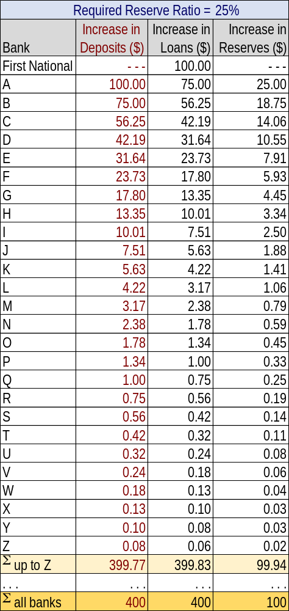
NTE 1010 – Introduction to Finance for Engineers
Money Supply
Multiple Deposit Creation
Central Bank’s purchase of 100 m$ worth bonds
from the First National Bank
eventually leads to
a 400 m$ expansion in deposits
with a 25% Required Reserve Ratio.
Δ Deposits = Δ Reserves * Simple Deposit Multiplier
where
Simple Deposit Multiplier = 1 / Required Reserve Ratio

Slide 14
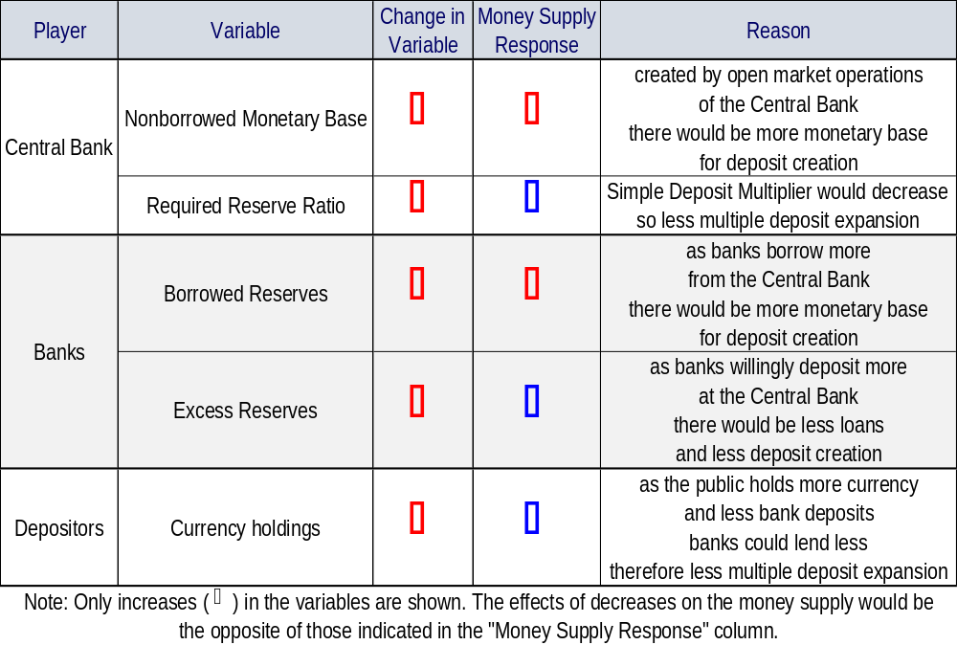
NTE 1010 – Introduction to Finance for Engineers
Money Supply
Overview

